Slide 1
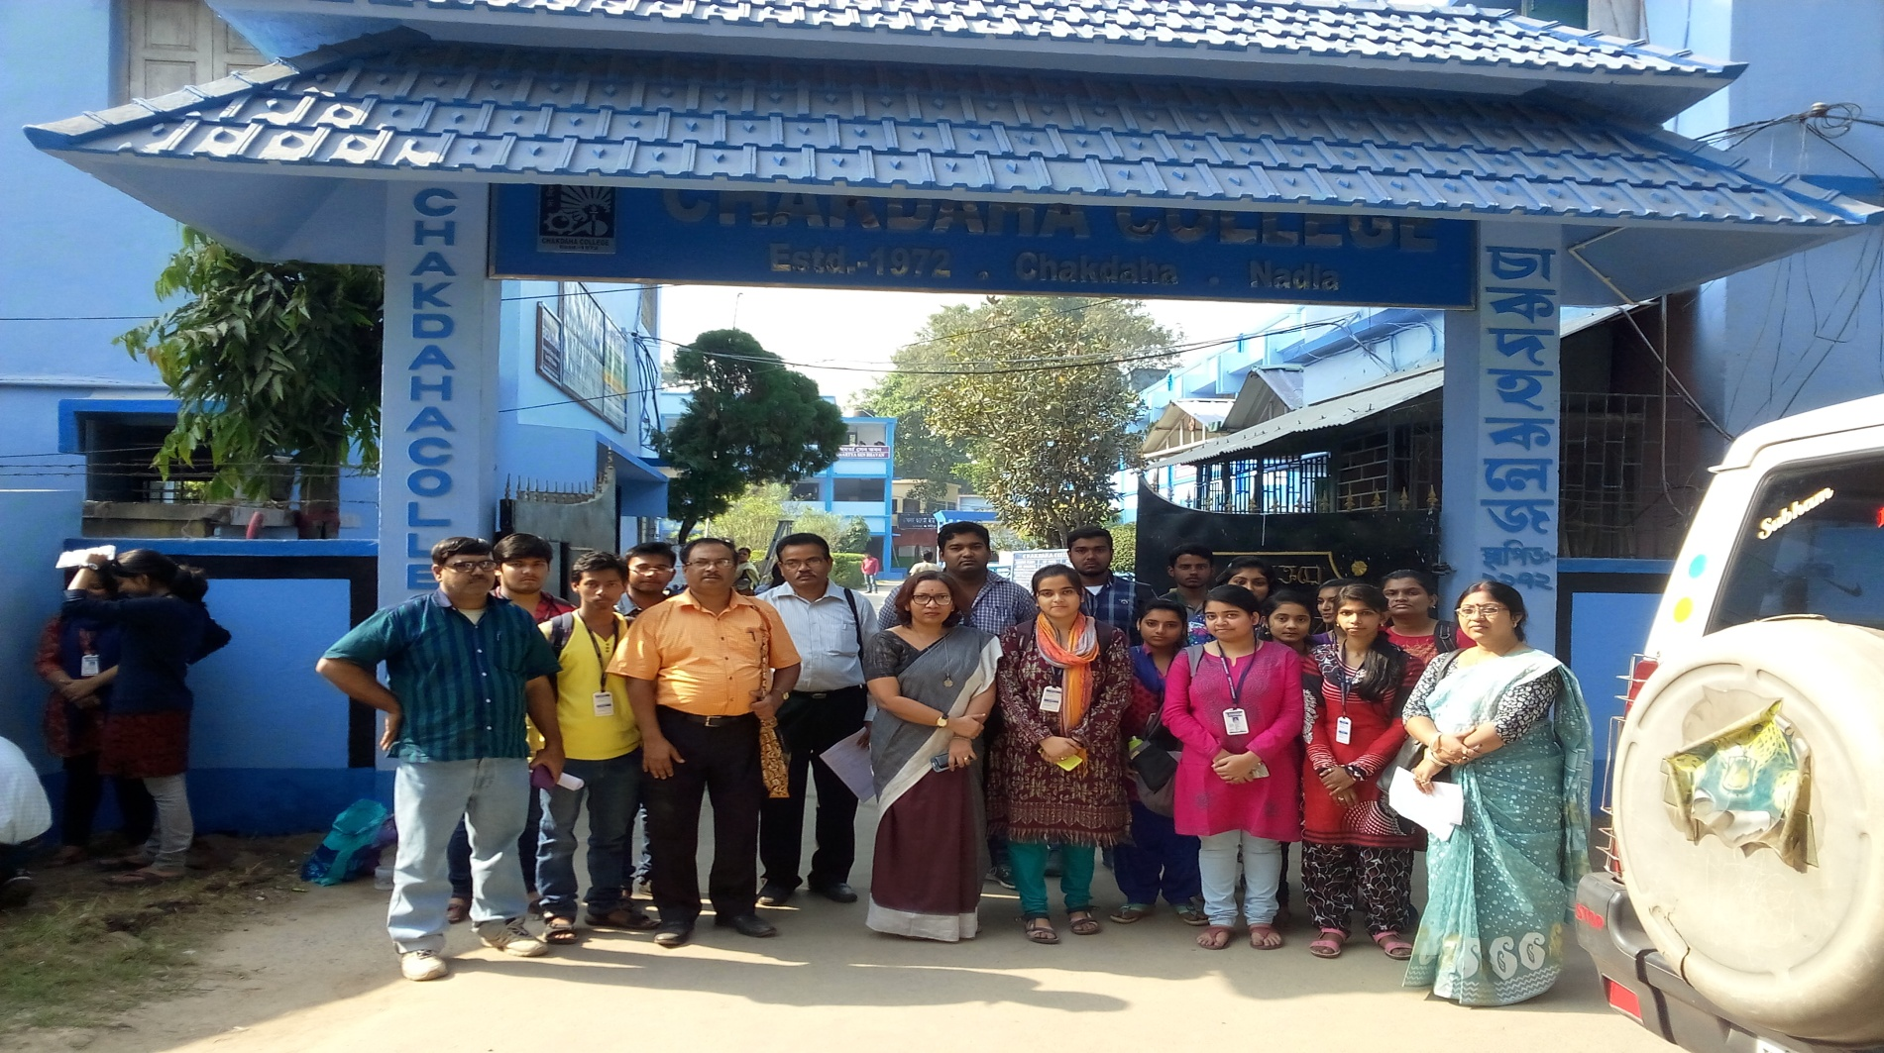
WELCOME TO THE DEPARTMENT OF ECONOMICS
AMARTYA SEN BHAVAN
CHAKDAHA College

Slide 2
BACKGROUND OF DEPARTMENT
1. YEAR OF ESTABLISHMENT:-
a. General Course: 1972
b. Honours Course: 1995
2. NAME OF THE PROGRAMME & COURSES OFFERED:-
B.A/ B. Sc Honours and
General Course

Slide 3
THRUST AREAS OF THE TEACHING- PART-1
MICROECONOMICS
(AKN)
MACROECONOMICS
(NKM & RS)
STATISTICS
(NKM)
MATHEMATICAL ECONOMICS
(SG)

Slide 4
THRUST AREAS OF THE TEACHING-PART–II
MACROECONOMICS
(AKM & RS)
STATISTICS
(NKM)
COMPUTER APPLICATION & PROJECT WORK
(AKN & NKM)
MICROECONOMICS
(NKM)

Slide 5
THRUST AREAS OF THE TEACHING-PART-III
INTERNATIONAL ECONOMICS
(AKN & RS)
PUBLIC FINACE AND ECONOMIC FINANCE
(AKN &NKM)
DEVELOPMENT THEORIES
(SG &RS)
RURAL DEVELOPMENT AND INTREPRENEURIAL ECONOMICS
(AKN & NKM)
INDIAN ECONOMICS
(NKM)
AKN= Dr. Arun Kr. Nandi (22 classes per week), 2. NKM = Dr. Nikhil Kr. Mandal(22 classes per week) 3. SG = Mrs . Swathi Ghosh(16 classes per week), 4. RS= Ria Sarker(8 classes per week)

Slide 6
Interdisciplinary Course & Other Department Involvement
a. Mathematics
b. Statistics
c. Computer Science
d. Political Science
e. History
f. Geography and
g. Commerce

Slide 7
NUMBER OF TEACHING STAFF
At the time of SSR submission :-
Associate Professor 1
Assistant Professor 1
Part-Time Lecturer 1
Guest Lecturers 4
At present:-
Associate Professor 1
Assistant Professor 1
Part-Time Lecturer 1
Guest Lecturer 1

Slide 8
FACULTY PROFILE WITH NAME, QUALIFICATION, DESIGNATION & SPECIALIZATION

Slide 9
PUBLICATIONS

Slide 10
PUBLICATION OF DR. ARUN KUMAR NANDI FOR LAST FIVE YEARS
PUBLISHED BOOKS AND STUDY MATERIALS:
PUBLISHED IN JOURNALS:

Slide 12
PUBLICATION OF DR. NIKHIL KUMAR MANDALFOR LAST FIVE YEARS
PUBLISHED IN BOOK
PUBLISHED IN EDITED BOOKS

Slide 13
PUBLISHED IN JOURNALS
Published in Seminar Proceedings
Published in College Magazine

Slide 14
FACULTIES CONTRIBUTION IN DIFFERENT FIELD OF RESEARCH FROM 2010 ONWARDS
PH.D AWARDED) – 2 & REGISTERED(FACULTY)- 1
PUBLICATION IN JOURNAL – 32
BOOKs- 2
EDITED BOOKS- 15
CONFERENCE VOLUMES- 4

Slide 15
PAPER ACCEPTED-8
COMMUNICATED -4
OTHERS- 3
PAPER PRESENTED- 35
ATTENDED -10

Slide 16
Number of Faculty with ongoing projects from National, International Funding Agencies
Name | Type | Sanctioned Amount | Source | Year | Level(Status)
1.Dr. Arun Kumar Nandi as PI | Minor Research Project | Rs. 80, 000/- | UGC | 2009-10 | National (Completed)
2. Dr. Arun Kumar Nandi as Co-Project Director | Sponsored Research Project | Rs.18,00,000/- (F . No.G-32/2015-16/ICSSR/RPS dated: 3011.2015 | ICSSR | 2015-16 | National (Approved) at West Bengal State University

Slide 17
FACULTY APPROVED BY
Faculty | Sanctioned | Filled | Approved
Assistant Professor | 4 | 2 | DPI, WB
Part-time Lecturer | 1 | 1 | DPI,WB
Guest Lecturer |  | 4 | College

Slide 18
FACULTY STUDENT RATIO
Student-Teacher Ratio:
i. 2014-15(Hons Course) 8:1
ii. 2015-16(Hons Course) 11:1
iii. 2016-17 (Hons Course) 9:1

Slide 19
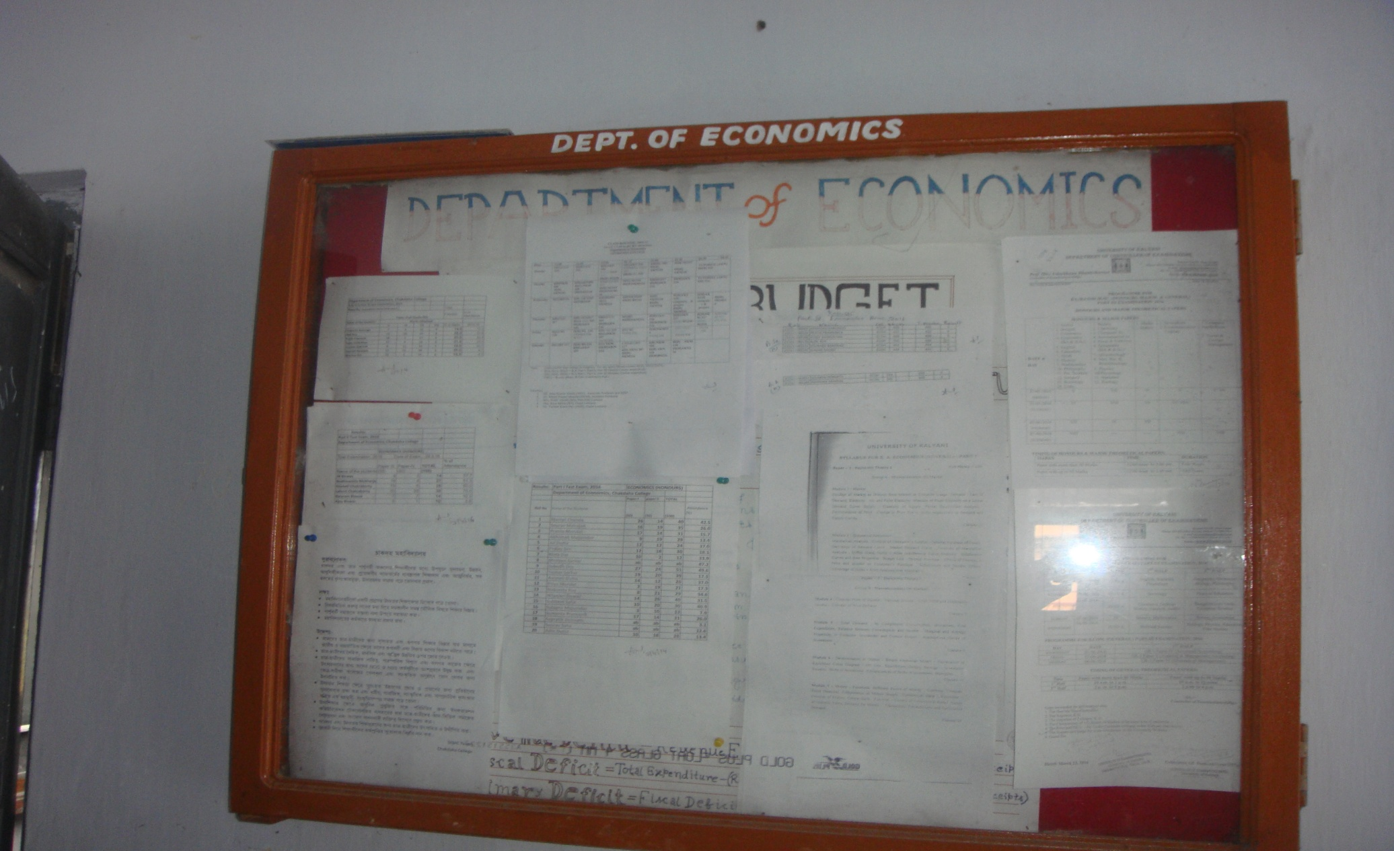
NOTICE BOARD

Slide 20
TEACHING LEARNING METHODS
CLASS ROOM LECTURES
CLASSES USING ICT
TUTORIAL CLASSES
COMPUTER LAB TRAINING
SEMINARS
GROUP DISCUSSION

Slide 21
INFRASTRUCTURE FACILITIES
COMPUTER LAB FACILITIES
LIBRARY FACILITY
CLASS ROOM WITH ICT
STUDENTS FRIENDLY DEPARTMENT

Slide 22
DEPARTMENTAL LIBRARY

Slide 23
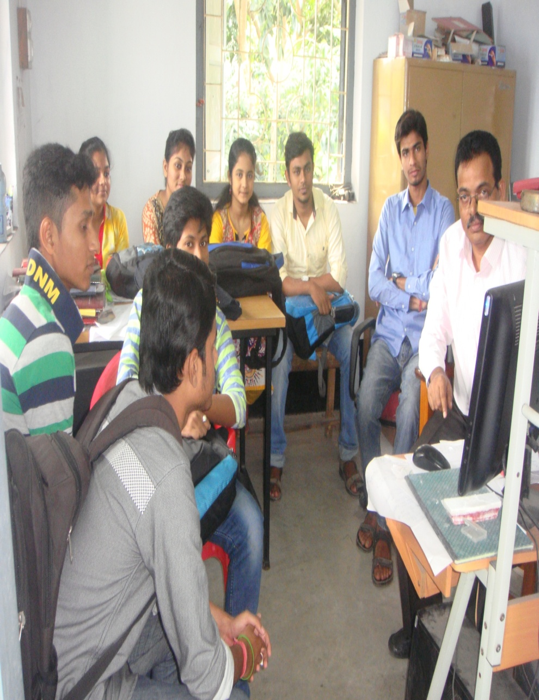
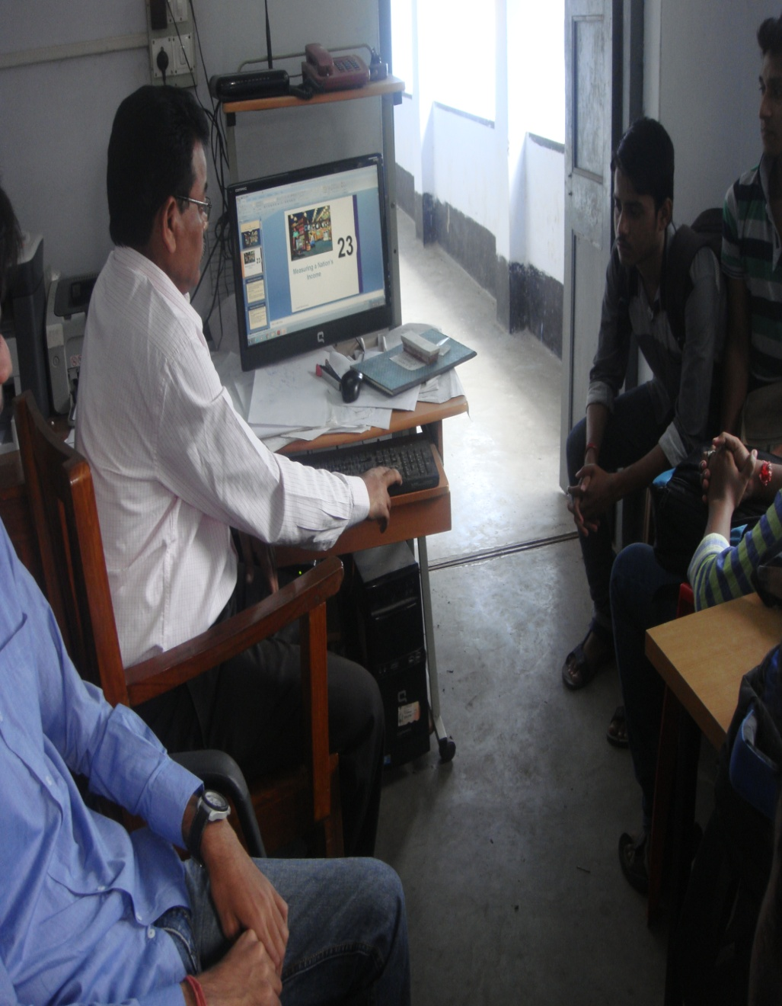
CLASS ROOM WITH ICT

Slide 24
HONOURS STUDENTS IN THE CLASS ROOM NO 216

Slide 25
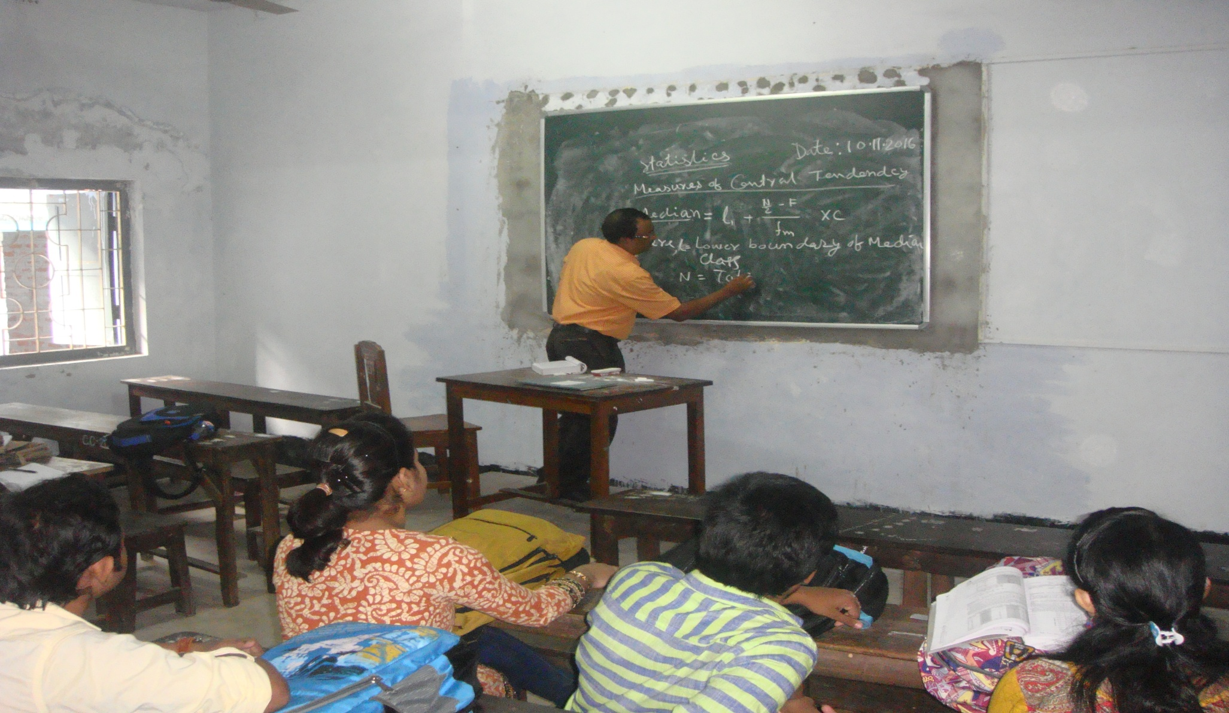
CLASS ROOM NO. 217

Slide 26
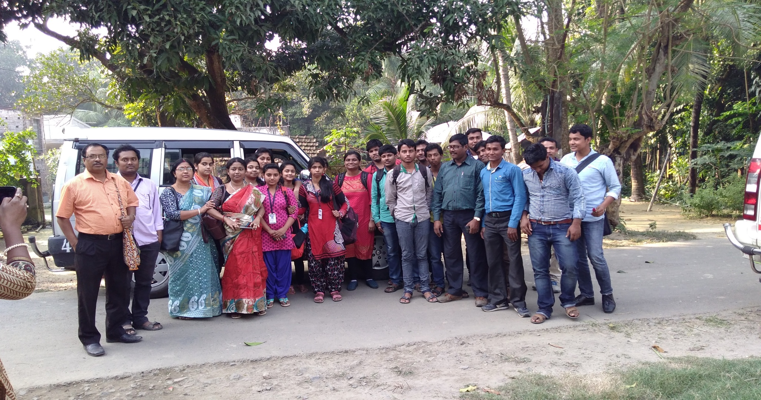
ICSSR PROJECT IN COLLABORATION WITH WBSU
FIELD SURVEY ON FLOWERS, FRUITS AND VEGETABLES AT BIJULI BLOCK UNDER RANAGHAT SUBDIVISION ,2016

Slide 27
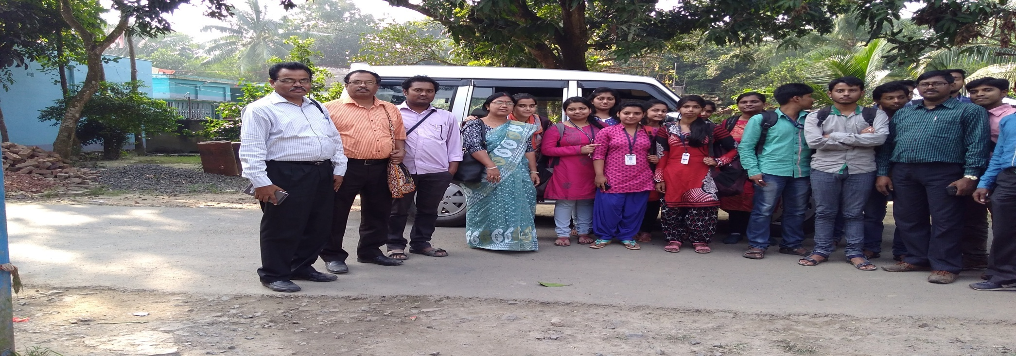
FILED SURVEY TEAM ,2016

Slide 28
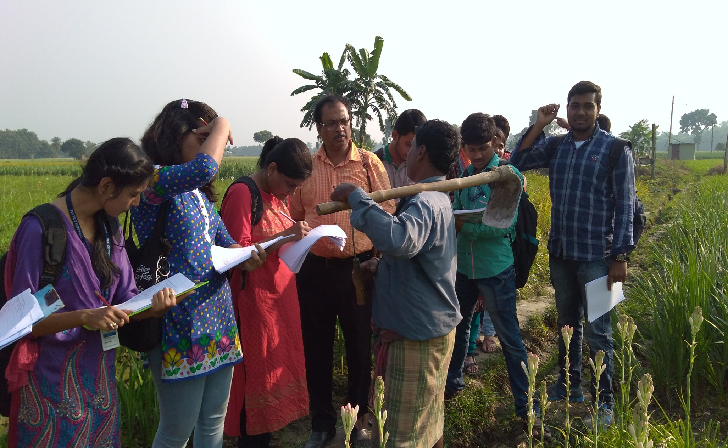
FIELD SURVEY, 2016

Slide 29
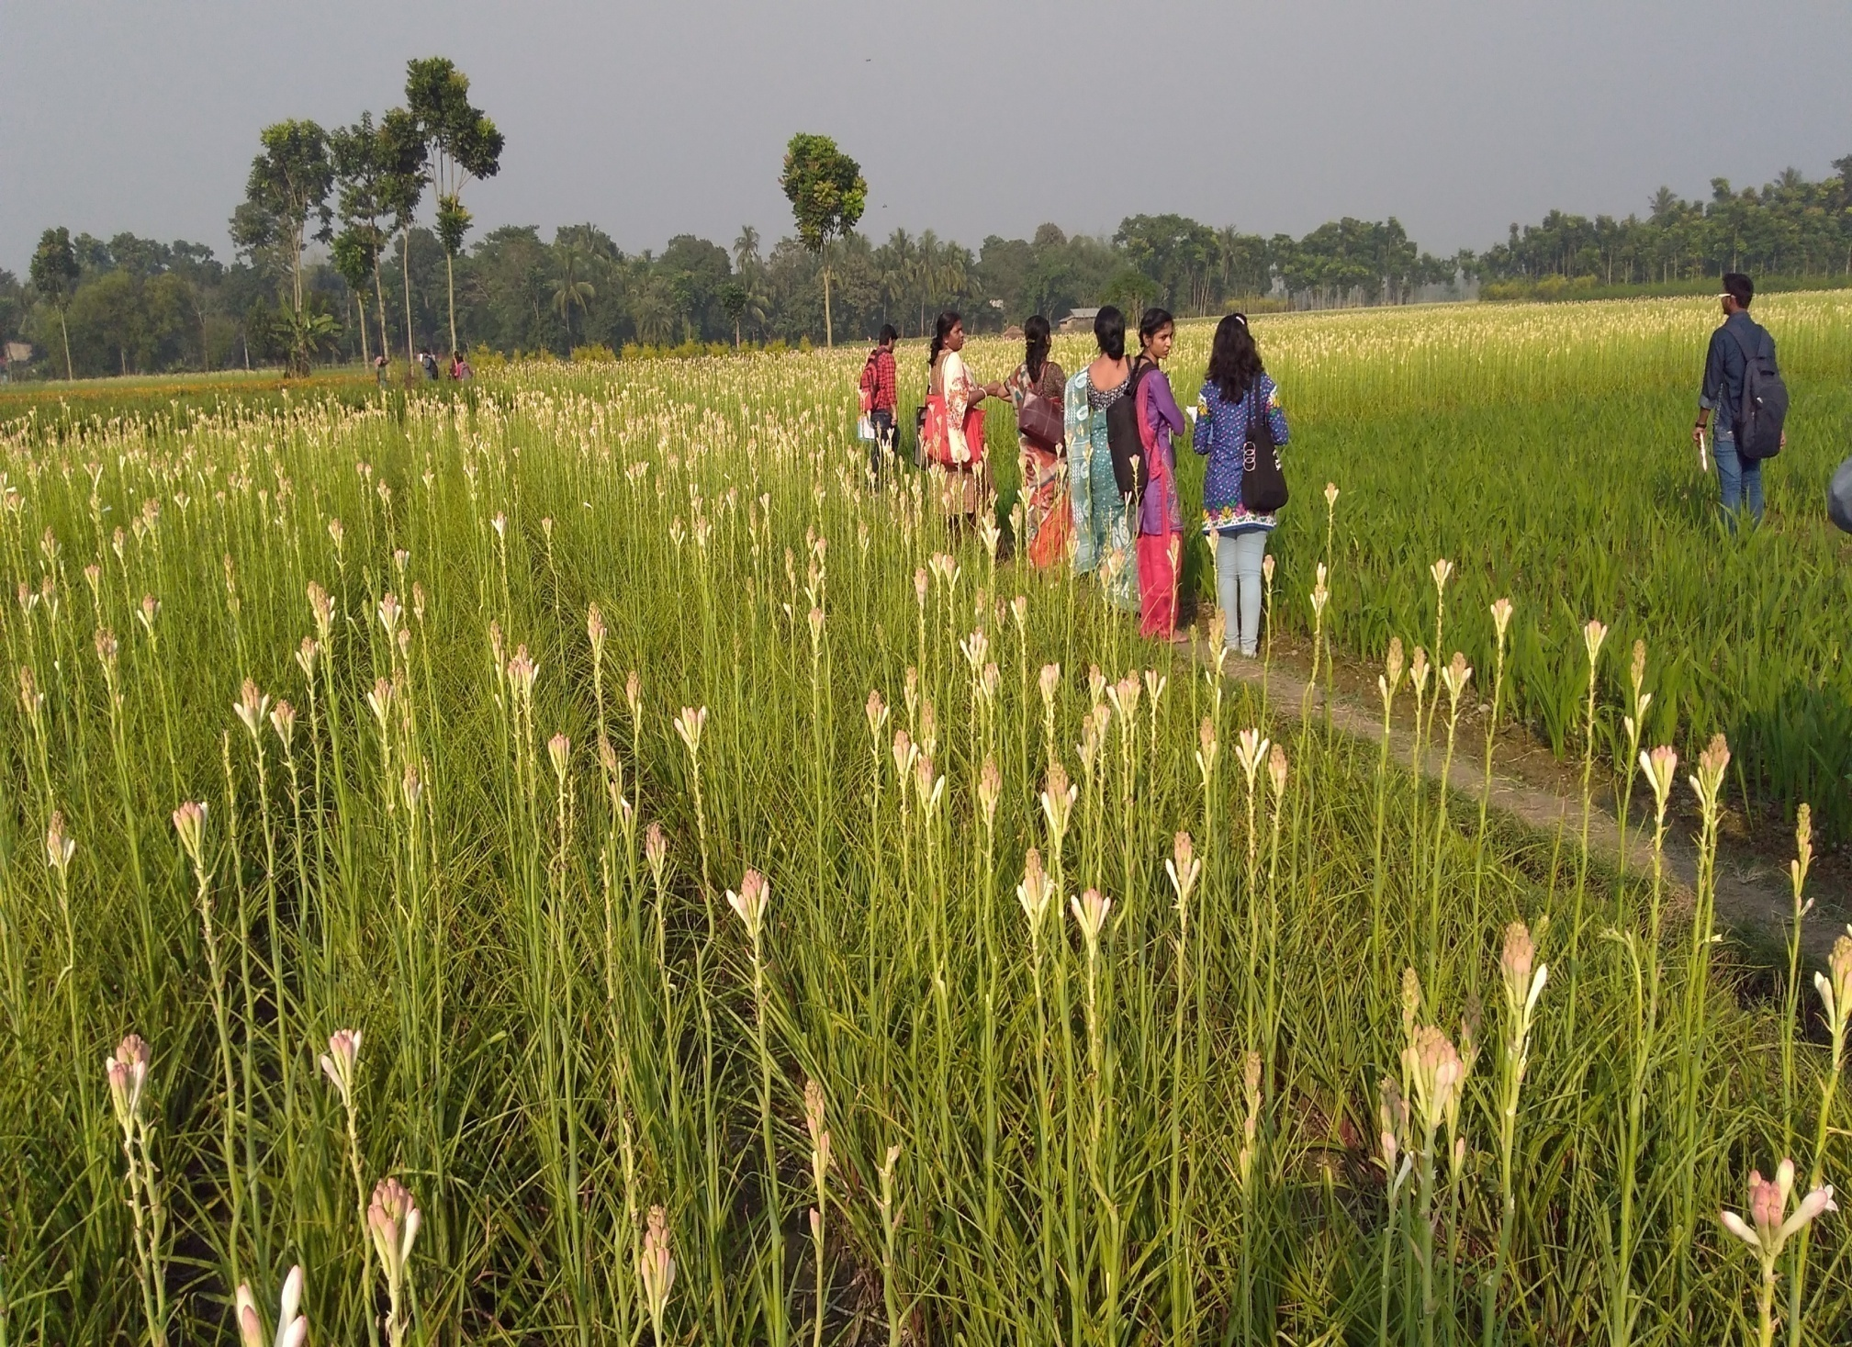

Slide 30
Students Progression
Students Progression | Against % Enrolled
UG to PG | 100% (approx)
PG to M. Phil. | Nil
PG to Ph.D. | Nil
Ph.D. to Post-Doctoral | Nil
Employed: Campus Selection Other than campus recruitment | See Next Slide
Entrepreneurship/Self-employed | Nil

Slide 31
EMPLOYED: 1. OTHER THAN CAMPUS RECRUITMENT
NAME | HIGHEST DEGREE | WORKING PLACE | REMARKS
DR AMIT BHANDARI | PH.D, KU | ASST. PROF.RBC COLLEGE | PH.D
DR.ABHIJIT BRAMBHACHARI | PH.D, KU | ASST. PROF, KANDI RAJ COLLEGE | NET
SEJUTI GUPTA | M.A | ASST. PROF. CHANDANNAGAR GOVT COLLEGE | NET
LABANYA PAL | M.A | ASST. PROF, BOLPUR COLLEGE | NET, SLET
RANADHIR DEY | M.A | PART-TIME LECTURER KALYANI COLLEGE | PH.D SCHOLAR,BU

Slide 32
STUDENTS PROFILE

Slide 33
ACHIEVEMENTS

Slide 34
CONT. ACHIEVEMENTS

Slide 35
CONT. ACHIEVEMENTS

Slide 36
WEAKNESS
1. SHORTFALL IN FULL-TIME FACULTIES
2. GEST TEACHERS WHO LEAVE DURING FULL ACADEMIC SESSION

Slide 37
OPPORTUNITIES
1.Upgradation of the students with theoretical Economics and providing them with ICT facilities
2.Field trips project arrangement for the student and orient them to trends in research
CHALLENGES
1.To attract good quality students to the admission in Economics Honours
2. To develop their technical skill in order to make them enable for higher studies in Economics and access more to job market

Slide 38
FUTURE PLANS
1. To open up a self-finance certificate course on Rural Development and Business Management jointly with the Department of Commerce
2. To involve students in Research and publication and create computerized data bank
3. To organize student oriented Seminar and workshop

Slide 39
THANK YOU

